Slide 1
AJITH G
B.Tech AI & DS
SINCET
NAAN MUDHALVAN PROJECT

Slide 2

LOAN APPROVAL PREDICTION:
3/21/2024 Annual Review

Slide 3


AGENDA
Overview of the project
Objectives and goals
Importance of loan approval prediction
Literature review of existing loan approval prediction models
3/21/2024 Annual Review

Slide 4

PROBLEM STATEMENT
In the contemporary financial landscape, the process of loan approval is often time-consuming and resource-intensive for both financial institutions and applicants.
To address this challenge, the project aims to develop a predictive model for loan approval.
The goal is to leverage historical data on loan applications, including applicant demographics, financial information, and credit history, to accurately predict the likelihood of loan approval for future applicants.

Slide 5

PROJECT OVERVIEW
Develop a predictive model: Utilize machine learning algorithms to build a robust model capable of predicting whether a loan application will be approved or denied.
Data Collection and Preprocessing: Gather relevant data from various sources including applicant information, financial history, credit scores, and loan outcomes. Clean and preprocess the data to ensure its quality and readiness for analysis.
Model Training and Evaluation: Train the predictive model using historical loan data, validate its performance through cross-validation techniques.

Slide 6

WHO ARE THE END USERS?
Borrowers
Loan Officers/Underwriters
Financial Institutions
Regulatory Agencies
Data Scientists/Analysts
Management and Stakeholders
Investors

Slide 7
YOUR SOLUTION AND ITS VALUE PROPOSITION
Improved Efficiency: By automating the loan approval process, financial institutions can significantly reduce the time and resources required for manual assessment.
Risk Mitigation: Machine learning models can analyze a wide range of applicant data, including credit history, income, employment status, and more, to accurately assess the risk associated with each loan application.
Enhanced Accuracy: By utilizing advanced algorithms, the loan approval prediction model can provide more accurate predictions compared to traditional methods, leading to fewer false positives and negatives.

Slide 8
THE WOW IN YOUR SOLUTION
Advanced Predictive Models: Implement state-of-the-art machine learning algorithms such as GBM Random Forests, or Neural Networks to build highly accurate prediction models.
Feature Engineering: Utilize innovative feature engineering techniques to extract meaningful insights from raw data.
Explainable AI (XAI): Incorporate Explainable AI techniques to provide transparency into the model's decision-making process. This ensures that stakeholders, including loan applicants and regulatory bodies.
‹#›

Slide 9
MODELLING
Data Collection: Gather data related to loan applications. This data should include features such as applicant's age, income, credit score, loan amount, loan term, employment status, etc., along with the loan approval outcome (approved or rejected).
Data Preprocessing:
Handle missing data: You may need to impute missing values or remove rows with missing data.
Encode categorical variables: Convert categorical variables into numerical format using techniques like one-hot encoding or label encoding.
Scale numerical features: Scale numerical features to ensure that they're on a similar scale, which can help improve the performance of some machine learning algorithms.
Feature Engineering: Create new features that might be useful for predicting loan approval.
Split Data: Divide the data into training and testing sets. Typically, you might use 70-80% of the data for training and the remaining 20-30% for testing.
‹#›

Slide 10
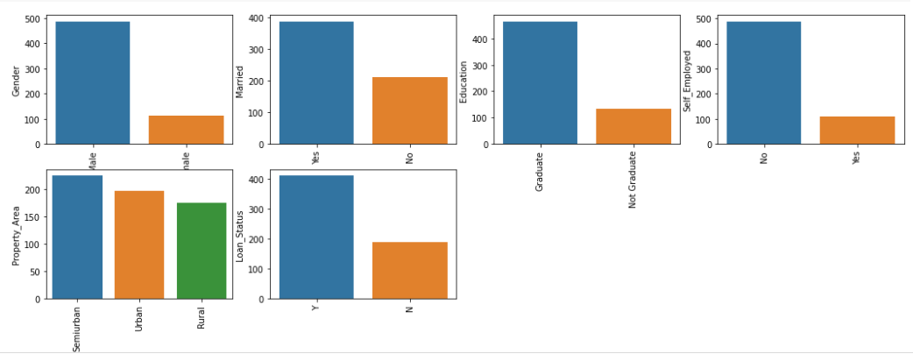
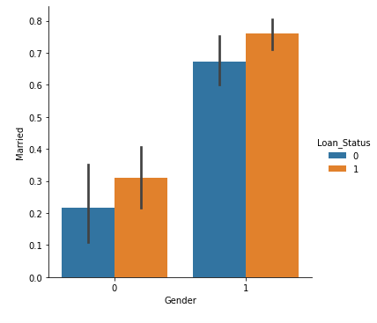
RESULTS
‹#›

